Slide 1
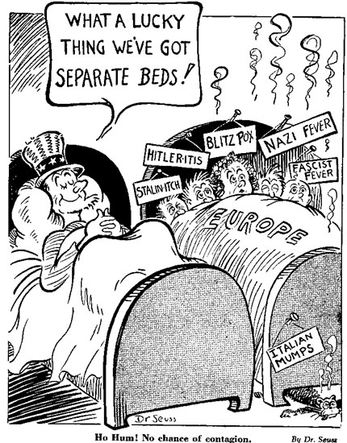
What is taking place in the picture?

Slide 2
Isolationism
United States stays out of world affairs

Slide 3
American foreign policy has always been, do not fight unless attacked. Many Americans watched what was going on in Europe and fearful that the event in Europe could change their world as well.

Slide 4
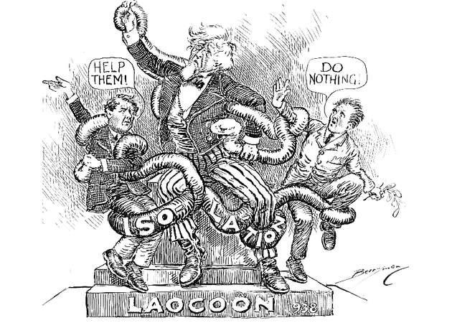
Neutrality
Not taking sides in a conflict

Slide 5
Neutrality Acts 1935-1937
U.S. will not send guns or loan money to countries at war.
U.S. can sell nonmilitary goods to countries at war
Must pay CA$H and CARRY the goods on their own ships.
Is the U.S. behaving like a neutral country?

Slide 6
September 1939
Germany attacks Poland on West
Russia attacks Poland on East
England and France say, “Stop!”
Declare war on Germany!
What should the U.S. do?

Slide 7
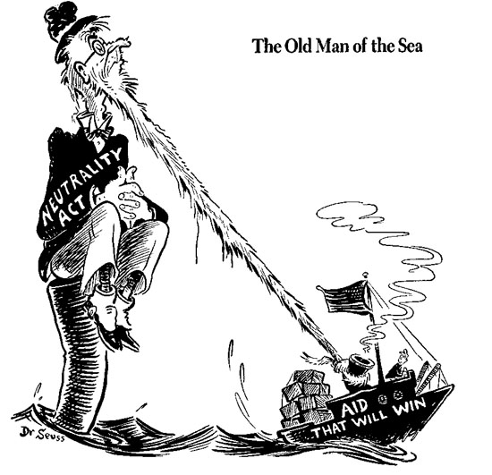
U.S. Changes Neutrality Laws 1939
U.S. can sell guns to a country at war if country pays in CA$H and CARRIES goods on it’s own ships

Slide 8
What is the difference between the Neutrality Acts?
1935-1937
U.S. will not send guns or loan money to countries at war.
U.S. can sell nonmilitary goods to countries at war
Must pay CA$H and CARRY the goods on their own ships.
1939
U.S. can sell guns to a country at war if country pays in CA$H and CARRIES goods on it’s own ships

Slide 9
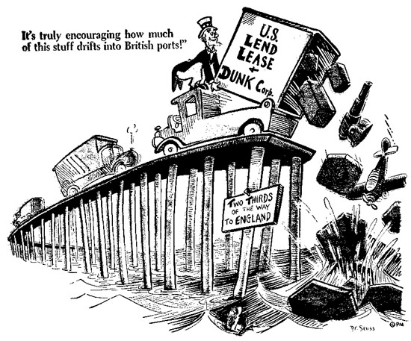
Lend-Lease
Britain does not have money to pay for war goods.
The U.S. will lend or lease [rent] the goods to them
FDR said that Britain was defending democracy against dictatorships
Is the U.S. behaving like a neutral country?

Slide 10
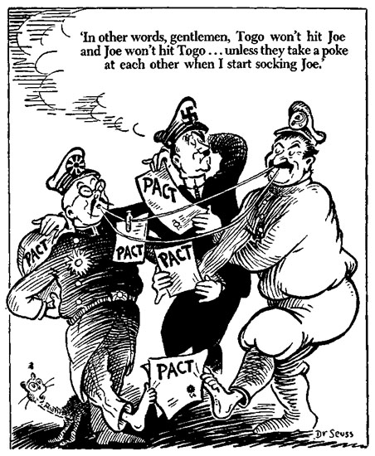
What is taking place?

Slide 11
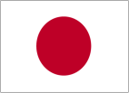
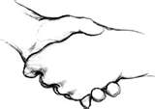
Alliance- agreement for nations to aid an protect on another
Axis
Germany
Italy
Japan
Allies
Britain
Soviet Union
France

Slide 12
United States and Japan
Japan takes over parts of China
U.S. refuses to sell oil and scarp metal to Japan
Embargo Act (restriction)
Japanese and American officials met
Ask the U.S, to lift the embargo
U.S. ask Japan to take armies out of China and Southeast Asia
NO COMPROMISE

Slide 13
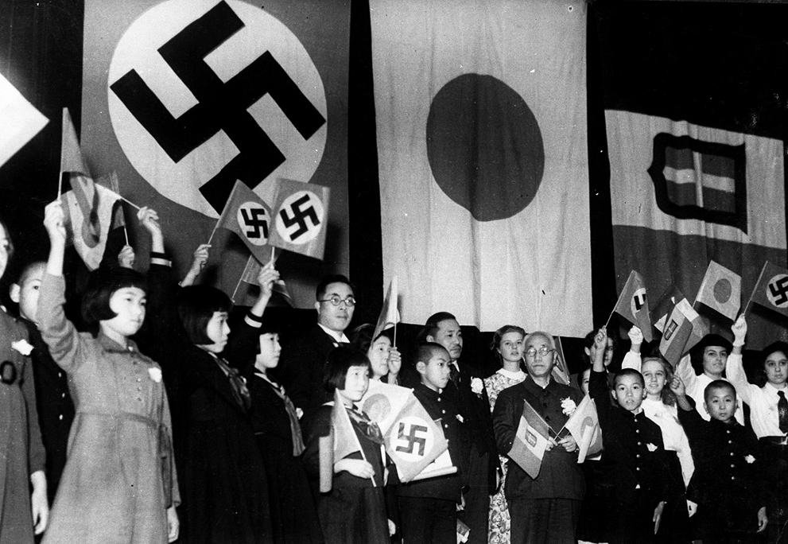
Japan
Joins Axis Powers
Germany
Italy
Japan
Who is part of the Allied Powers?
How will the U.S. react?

Slide 14
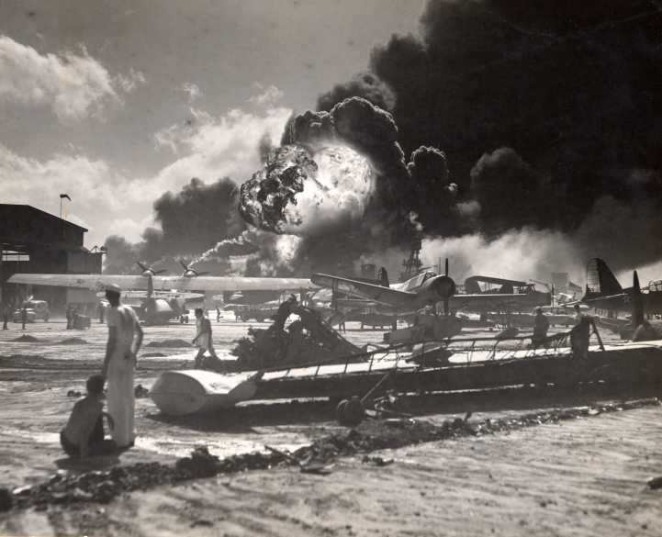
Pearl Harbor
December 7, 1941
183 Japanese airplanes bombed U.S. Naval and Air force base
Killed over 3,000 Americans
Destroyed almost all U.S. airplanes at base
Sank or badly hurt most U.S. ships

Slide 15
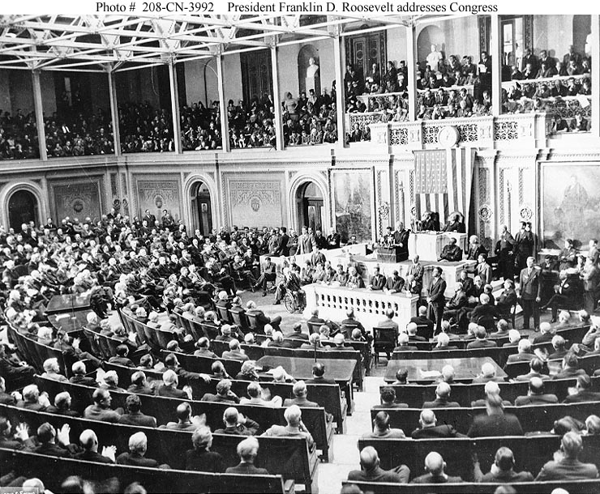
FDR Addresses Congress
“Yesterday, December 7, 1941—at date which will live in infamy”
“No matter how long it may take us to overcome this premeditated [planned] invasion, the American people, in their righteous [good] might [strength], will win absolute victory.”
U.S. declares war on Japan!

